Slide 1


Inspiration Guide
Using tyntec APIs in mobility

Slide 2

tyntec at-a-glance
Our Mission Power human connection at scale
Our Space A global cloud communications platform, enabling businesses to interact with people across any mobile channel
Our Origin Messaging platform architected by the founding CTO – and protected by several patents
Our Footprint German-based R&D, US-based messaging hub with operations in North America, Europe and Asia, connecting 150 countries around the world

Slide 3


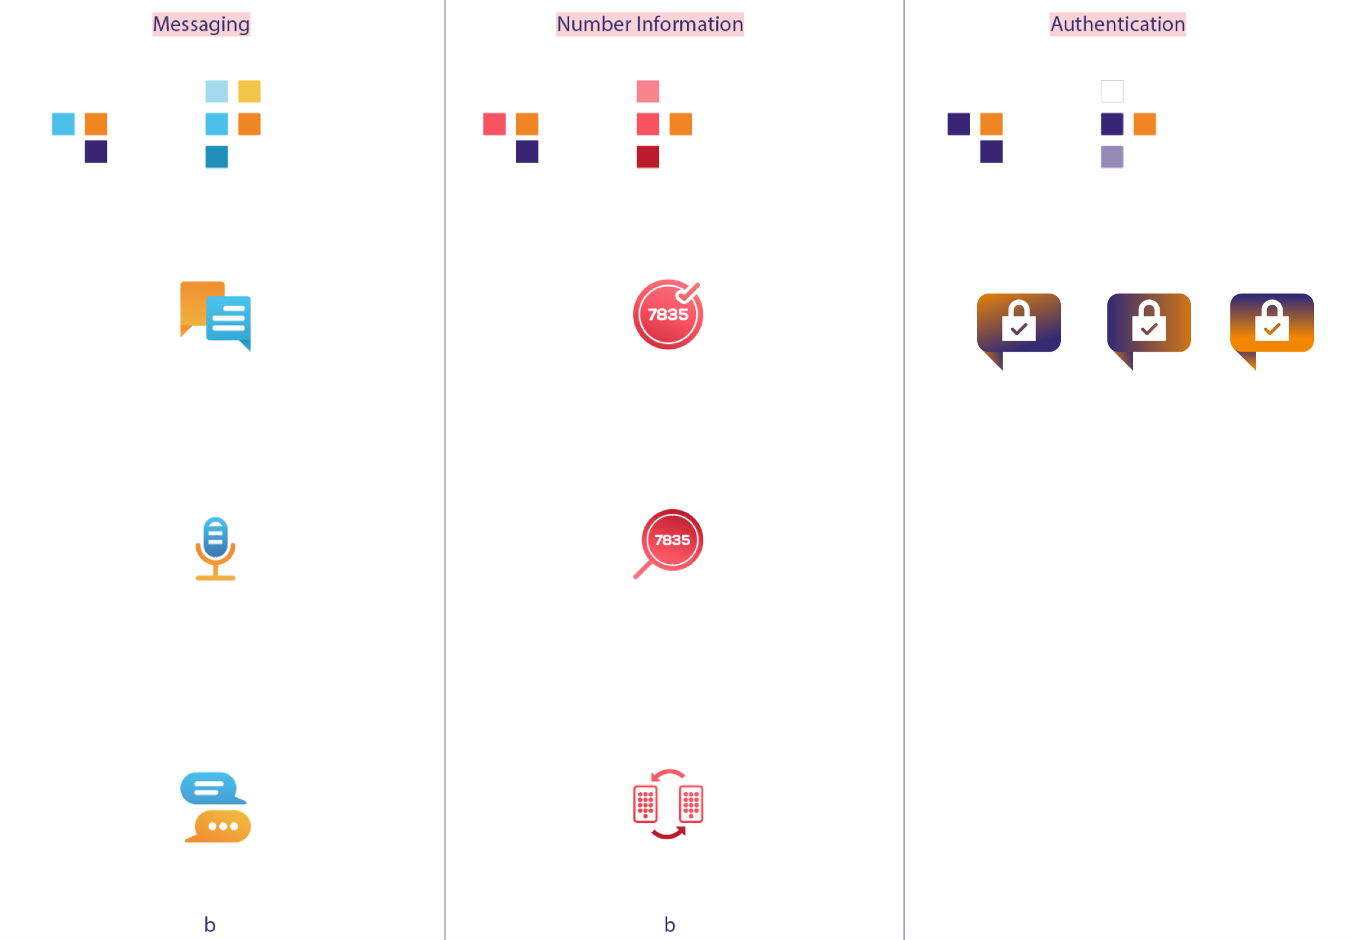
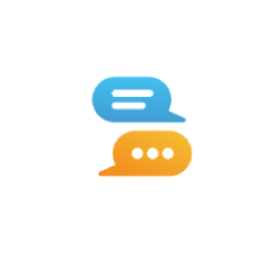



CPaaS-Powered Mashups
CRM
One Access Point. Limitless Possibilities.
SMS Reach anyone fast, one- or two-way
Mobile Chat Engage customers on their preferred apps
Voice Add voice calling to any apps or websites
Number Information Keep the database clean, optimize routing
Authentication Block fraudsters, safeguard critical transactions

Slide 4

Some Inspiration?
User verification
Account protection
Application/ Machine to Person Notification
Notes:
Click Icon or Drag the picture and Right Click> Send to Back

Slide 5
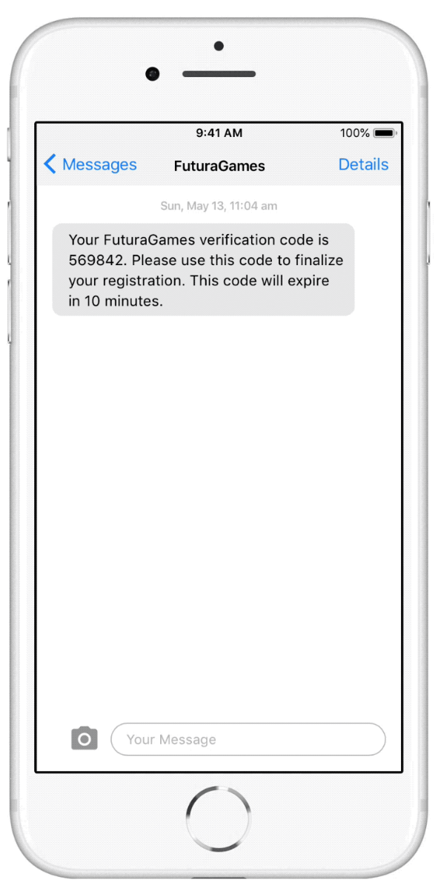
User Verification
Sign up new users without getting fooled by fake account bots
Confirm new users’ identities at registration (app download or online form) with two-factor authentication.

Slide 6
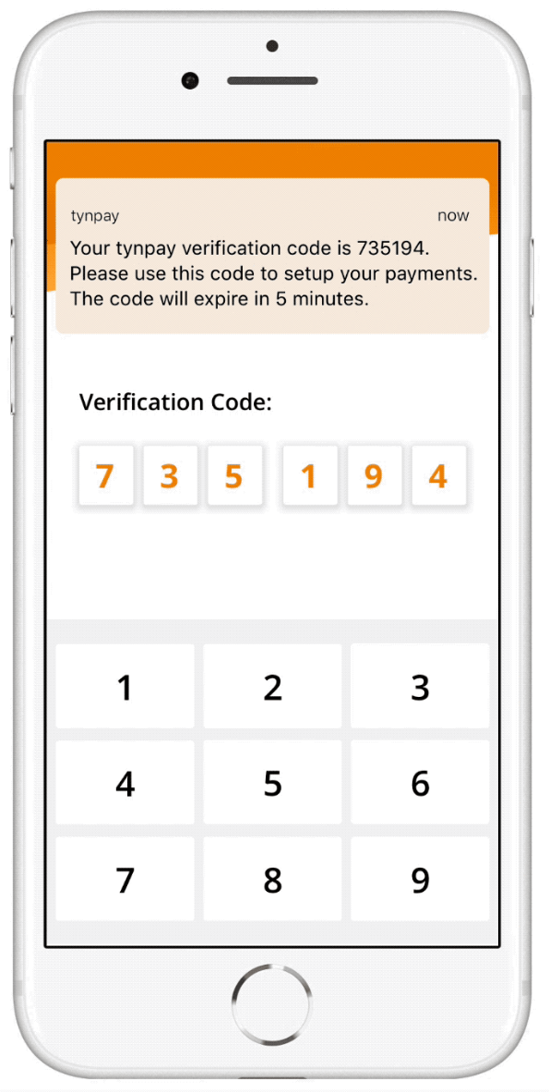
Authenticate transactions and accounts for increased protection
Defeat fraudulent online accounts and transactions, and comply with consumer protection regulations with user-friendly two-factor authentication. Combine with continuous account 2FA for maximum protection

Slide 7

Combine the mobile phone with contextual data for secure, user-friendly 2FA
This robust API detects the phone number type (mobile or landline) and sends the passcode via the appropriate channel (SMS or voice). Includes with multi-language and customization support.

Slide 8
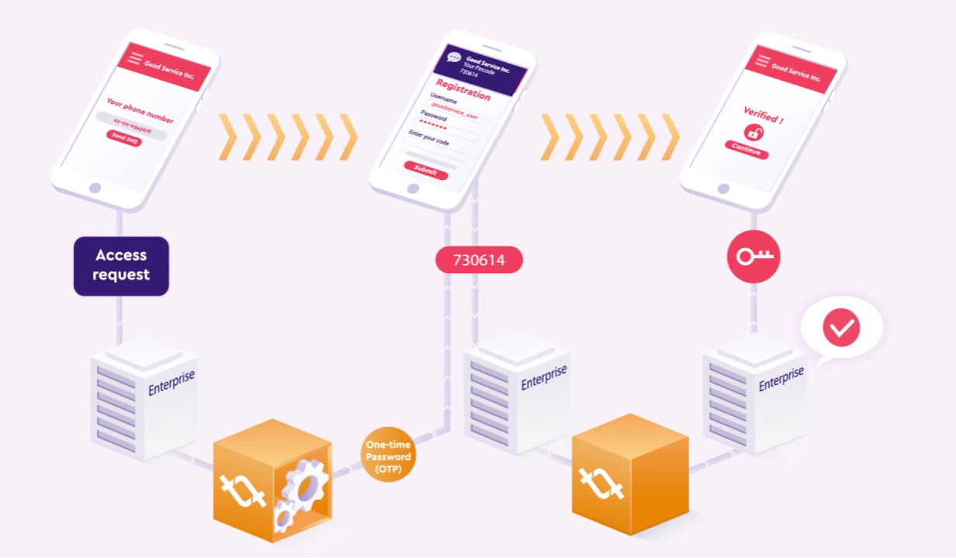
How it works

Slide 9
Some sample code?
# Send an otp with minimum mandatory values:
curl \ -X POST "https://api.tyntec.com/2fa/v1/otp?number<TEL_NUMBER>"
-H "accept: application/json" \
-H "apikey: <YOUR_API_KEY>"
# Check an OTP code:
curl \ -X POST "https://api.tyntec.com/2fa/v1/otp/<OTP_ID>/check?otpCode=<OTP_CODE>"
-H "accept: application/json" \
-H "apikey: <YOUR_API_KEY>"
Check our tech docs → https://docs.tyntec.com/en/content/authentication/2fa-api

Slide 10
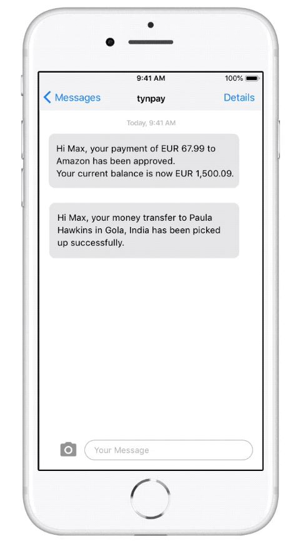
Application / Machine to Person Notification
Keep your users in the loop
Empower users by giving them updates about what is going on in the machine world. Without the need for having a smartphone or downloading an app.

Slide 11
Some sample code?
# Send an SMS with minimum mandatory values:
Curl \
-X POST "https://api.tyntec.com/messaging/v1/sms?to=<NUMBER_TO>&from=<NUMBER_FROM>&message=<MESSAGE_BODY>"
-H "accept: application/json" \
-H "apiKey: <YOUR_API_KEY>"

Slide 12

Powerful APIs with Programmable Features
Cloud advantage with flexibility
Frictionless integration
Low investment & commercial flexibility
Programmability & customizable features
Fast deployment & on-demand scalability
Monitoring & control for governance
Possibility for data/solution integration

Slide 13

tyntec by the Numbers

Slide 14

Let´s build this
tyntec powers omni-channel communications, making it easy for mobility brands to reach consumers and conduct conversational commerce throughout the shopping journey. Backed by its industry-leading global network, tyntec provides easy-to-integrate APIs for SMS, mobile chat, number verification and authentication for fast, secure mobile communications.

